Slide 1

Vivekananda institute of Technology and science
A Major Project Review on
“Blockchain Based Accounts Payable Platform for Goods Trade”
Under the Guidance of
Dr .M.V. Hanumantha Reddy
CSE Dept Vits.
Submitted by
B. Srinivas (21N61A0548)
V. Rohan (21N61A0535)
A. Varun Kumar (21N61A0552)
V. Lavan Kumar (21N61A0527)

Slide 2

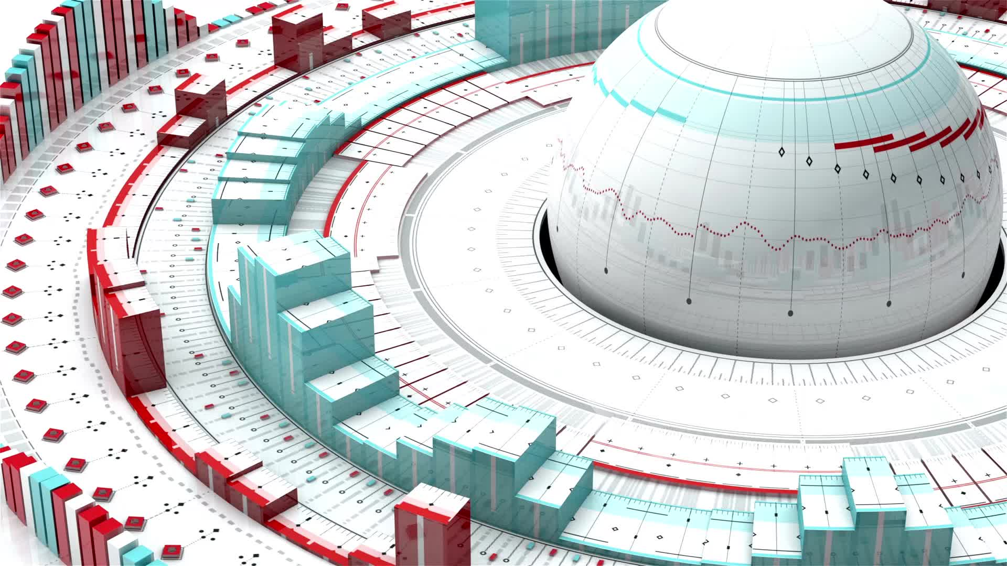
ABSTRACT
Goods trade is a supply chain transaction that involves shippers buying goods from suppliers and carriers providing goods transportation
Goods trade involves multiple parties (shippers, suppliers, carriers) and several business documents.
Discrepancies during transport, delivery, or invoicing lead to disputes and delays, increasing operational costs
Shippers must verify received goods, process invoices, raise claims, and adjust payments — a time-consuming and manual process.
The proposed system uses blockchain technology to automatically generate claim advices for deficiencies and adjust supplier/carrier payments.
This approach reduces disputes, eliminates redundancy between AP and AR teams, and accelerates the accounts payable process through smart contract-based automation.

Slide 3
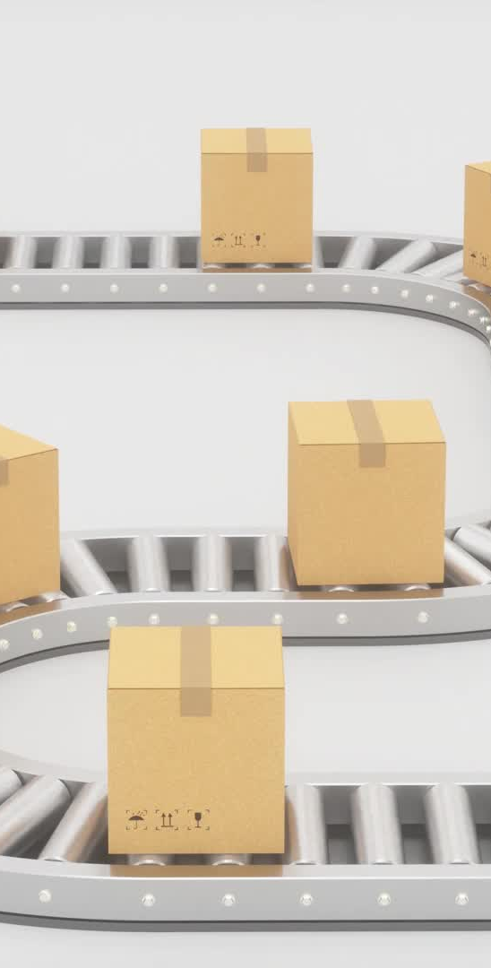
EXISTING SYSTEM:
Uses platforms like TradeLens to track freight transport using blockchain.
Supports e-invoicing for suppliers and carriers after goods delivery.
Discusses invoice matching (e.g., 3-way matching) using blockchain for validation
Invoice processing usually starts only after the goods are delivered, delaying claim generation..

Slide 4
Manual processes increase errors and processing time.
DISADVANTAGES:
Delayed dispute handling, as claims start after delivery.
Manual processes increase errors and processing time.
Lack of real-time visibility leads to slower reconciliation.
Complex handoffs between parties make the goods trade more error-prone and time-consuming.

Slide 5
PROPOSED SYSTEM
Introduces a blockchain-based accounts payable system to automate invoice and dispute handling.
Uses smart contracts to generate Claim Advice (CA) and Payment Advice (PA) from trade documents
Dispute resolution before payment.
Audit trails to track actions securely.

Slide 6


ADVANTAGES:
Faster and efficient processing using blockchain transparency and automation.
Prevents overpayment
Reduces disputes and delays through early claim generation
Improves trust and coordination across the entire supply chain network.

Slide 7
SYSTEM SPECIFICATION
Hardware Requirements:
System : Pentium IV
Hard Disk : 20 GB.
Monitor : SVGA
Mouse & Keyboard : Standard
Ram : 4 GB.

Slide 8
Software Requirements:
operating system : Windows Xp
Coding Language : Java/ J2EE (JSP, Servlet)
Data Base : MY SQL.
Frontend : J2EE
Web Server : Tomcat 6.0

Slide 9
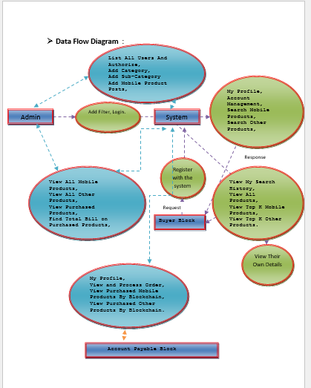
System Architecture :

Slide 10
Modules:
Seller Block
Account Payable Block

Slide 11
MODULES DESCSRIPTION:
Seller Block
In this module, the Seller Block has to login by using valid user name and password. After login successful he can do some operations such as List All Users And Authorize, Add Category, Add Sub-Category Add Mobile Product Posts, Add Other Product Posts, View All Mobile Products, View All Other Products, View Purchased Products, Find Total Bill on Purchased Products, List All Reviewed On Mobile Posts, List All Reviewed On Other Posts, List All Search History, View All Users product searched, View Mobile rank in chart, View Other Products rank in chart, View product search ratio in chart.

Slide 12
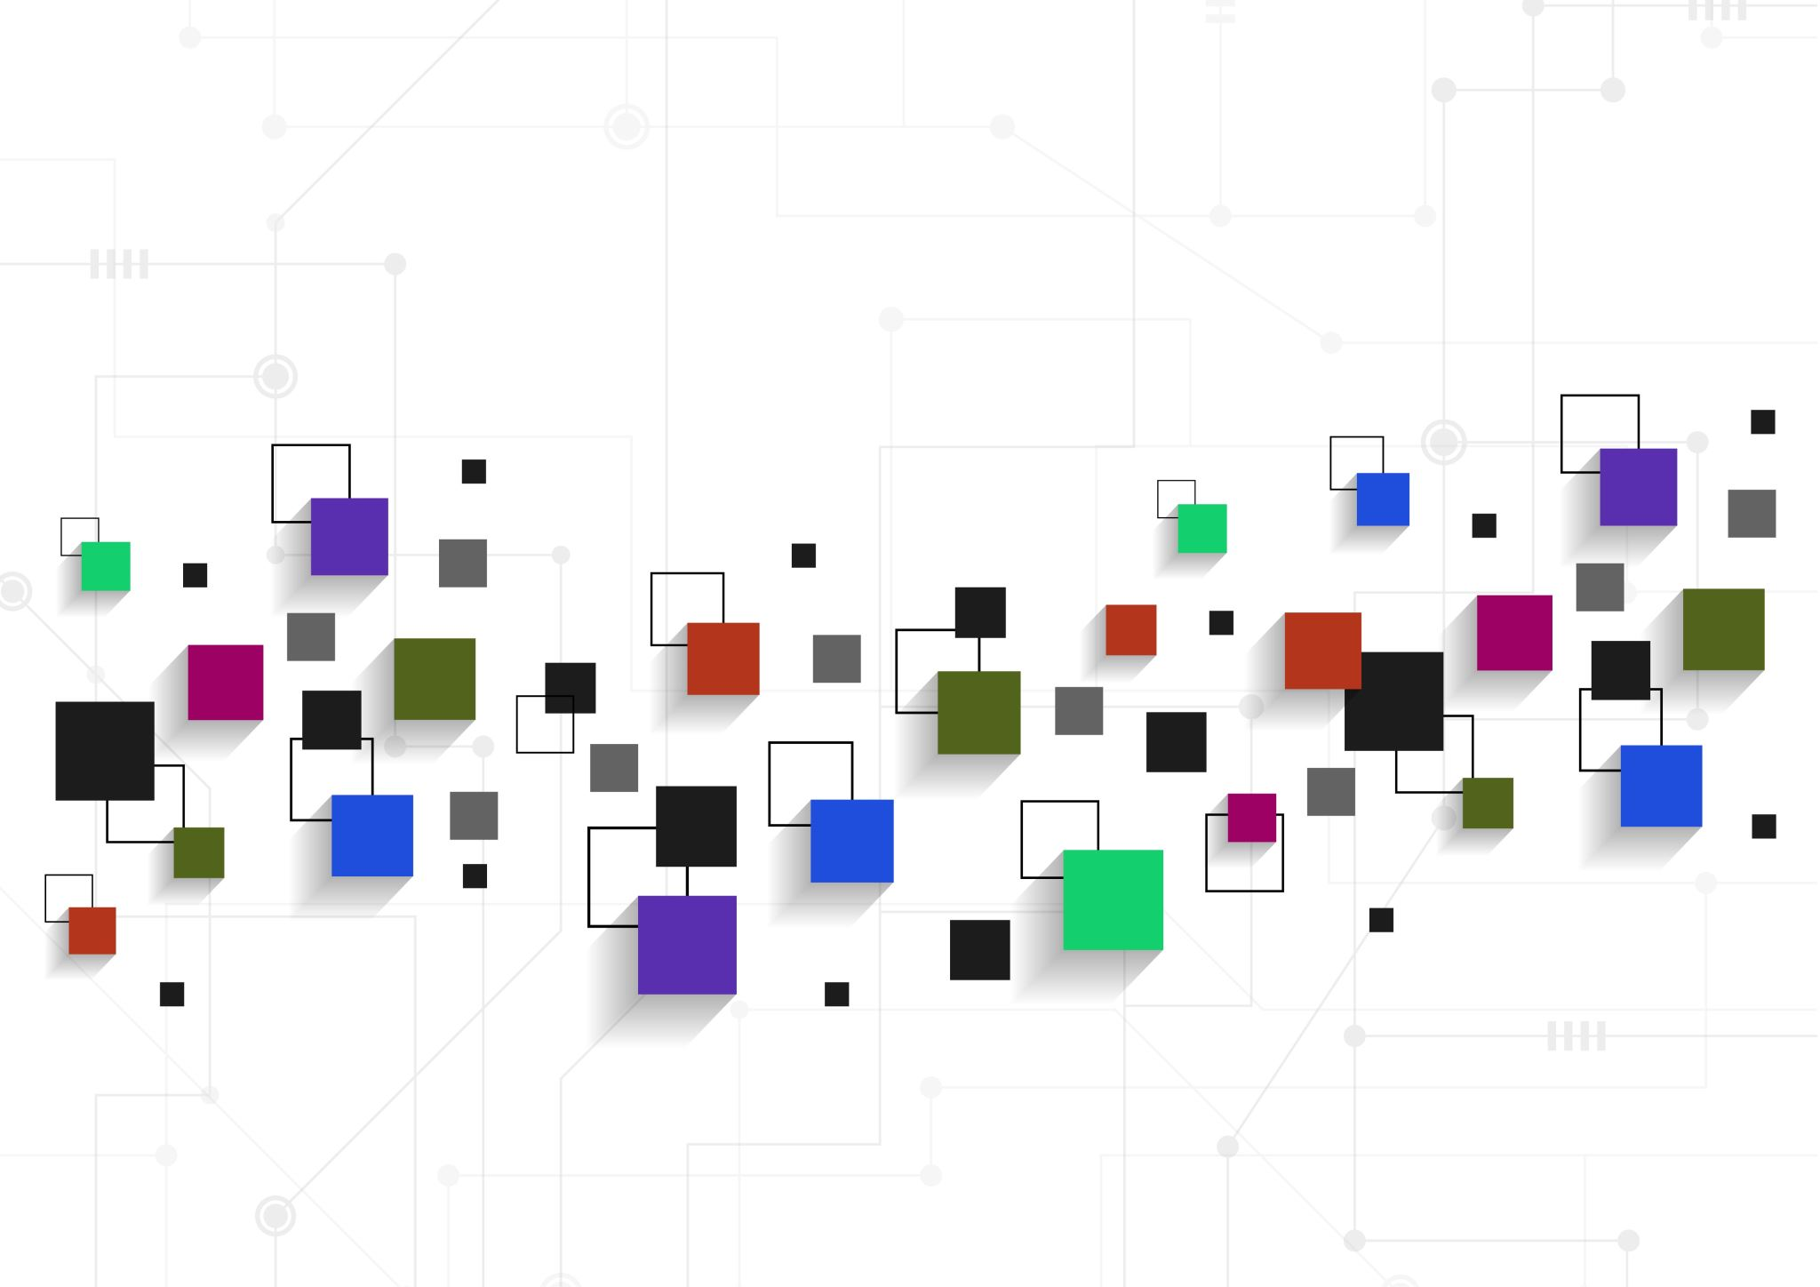
Account Payable Block:
Add App
In this module, there are n numbers of Account Payable Block are present. User should register before doing some operations. After registration successful he has to login by using authorized username and password. Login successful he will do some operations like the My Profile, View and Process Order, View Purchased Mobile Products By Blockchain ,View Purchased Other Products By Block chain.
Buyer Block
In this module, there are n numbers of users are present. User should register before doing some operations. After registration successful he has to login by using authorized user name and password. Login successful he will do some operations like Account Management,Search Mobile Products,Search Other Products,View My Search History,View All Products,View Top K Mobile Products,View Top K Other Products.
Search for top K applications:
In this module, user enter the application name and select the top N details then leading app details will be displayed such as applicationname,app description, mobile type, users, file name, application images and ratings will be displayed.

Slide 13
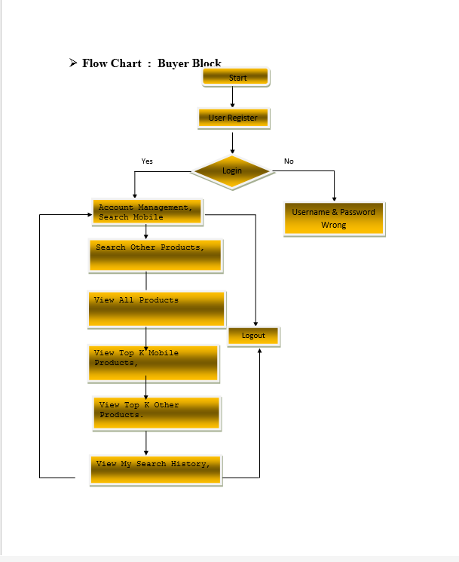
UML Diagrams:

Slide 14
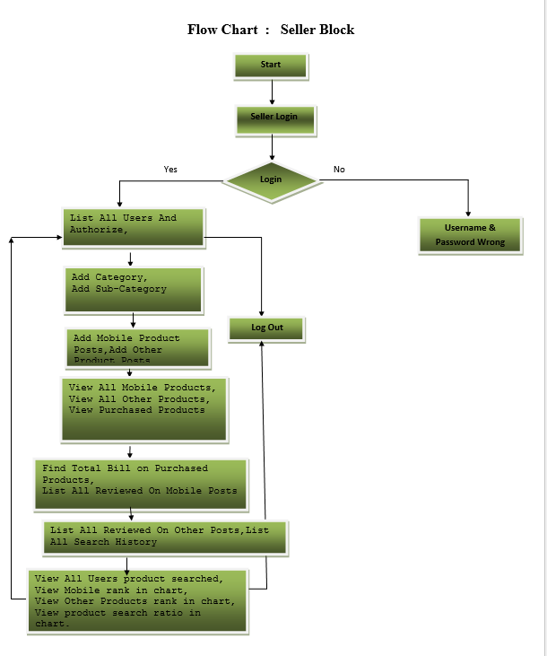

Slide 15
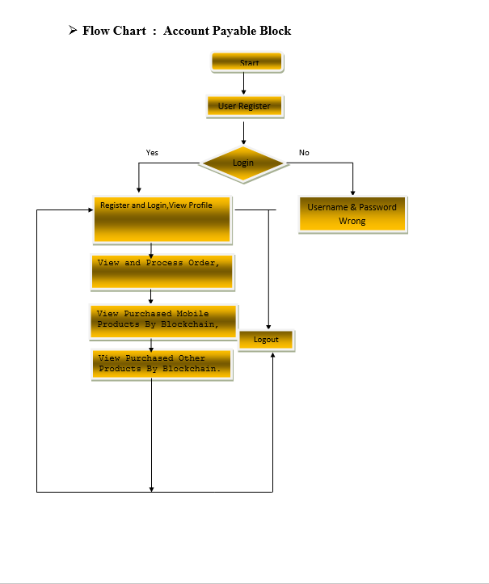

Slide 16
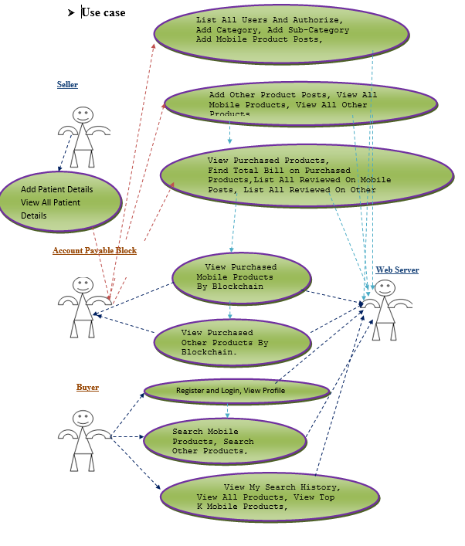
Use case Diagram :

Slide 17
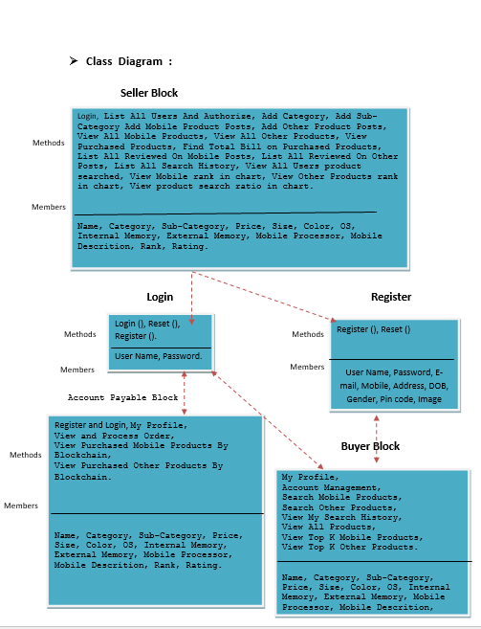
Class Diagram:

Slide 18
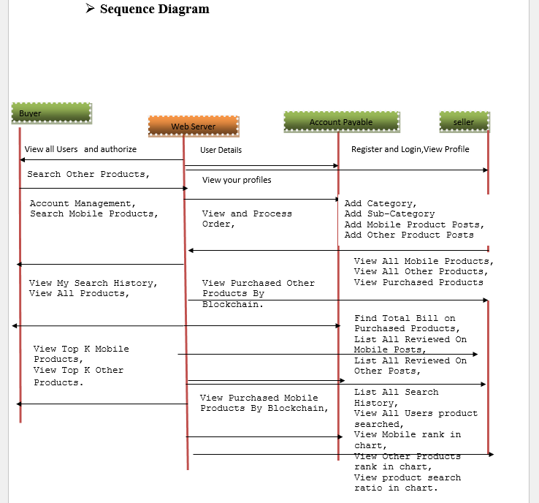
Sequence Diagram :

Slide 19
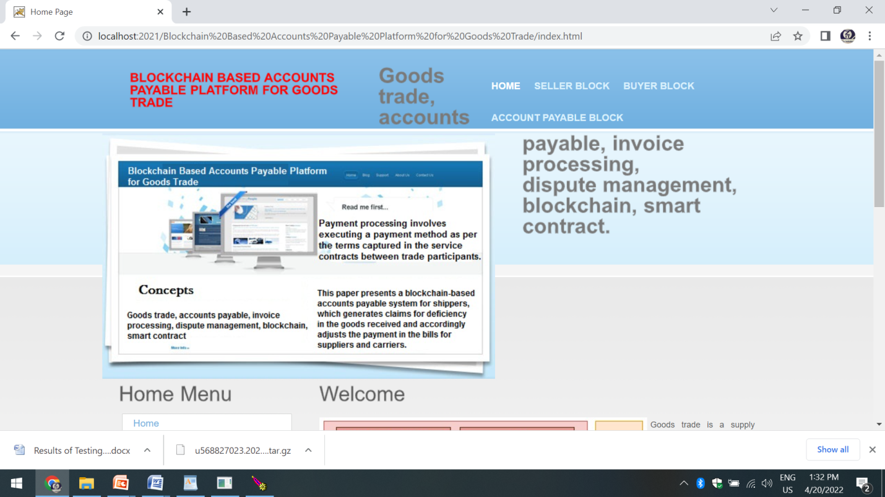
Output Screens:

Slide 20
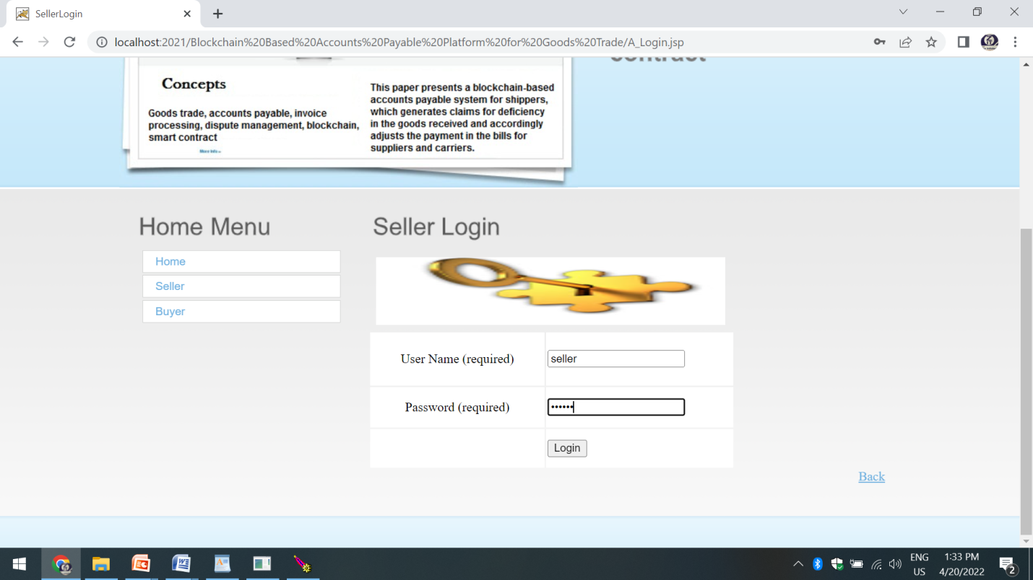

Slide 21
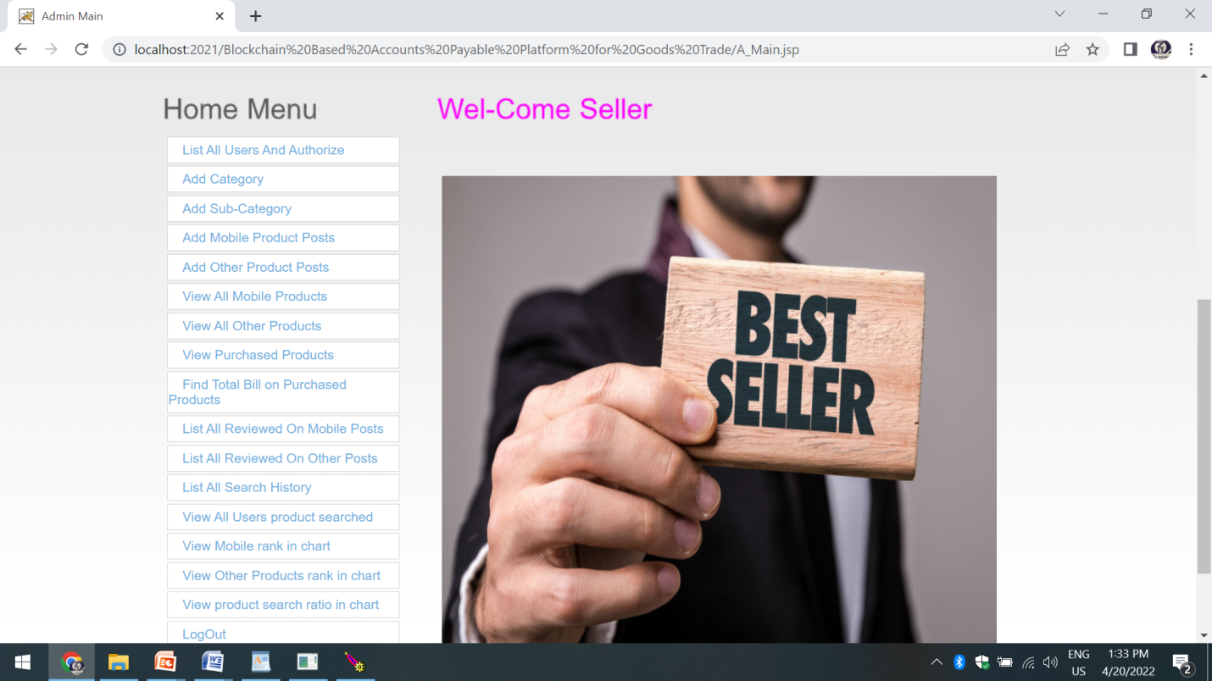

Slide 22
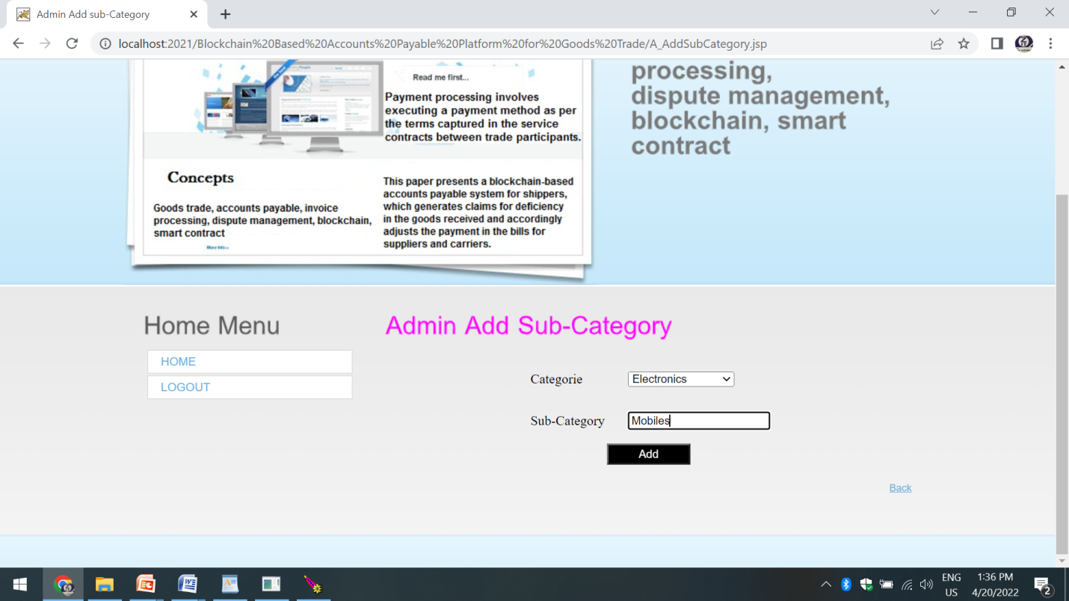

Slide 23
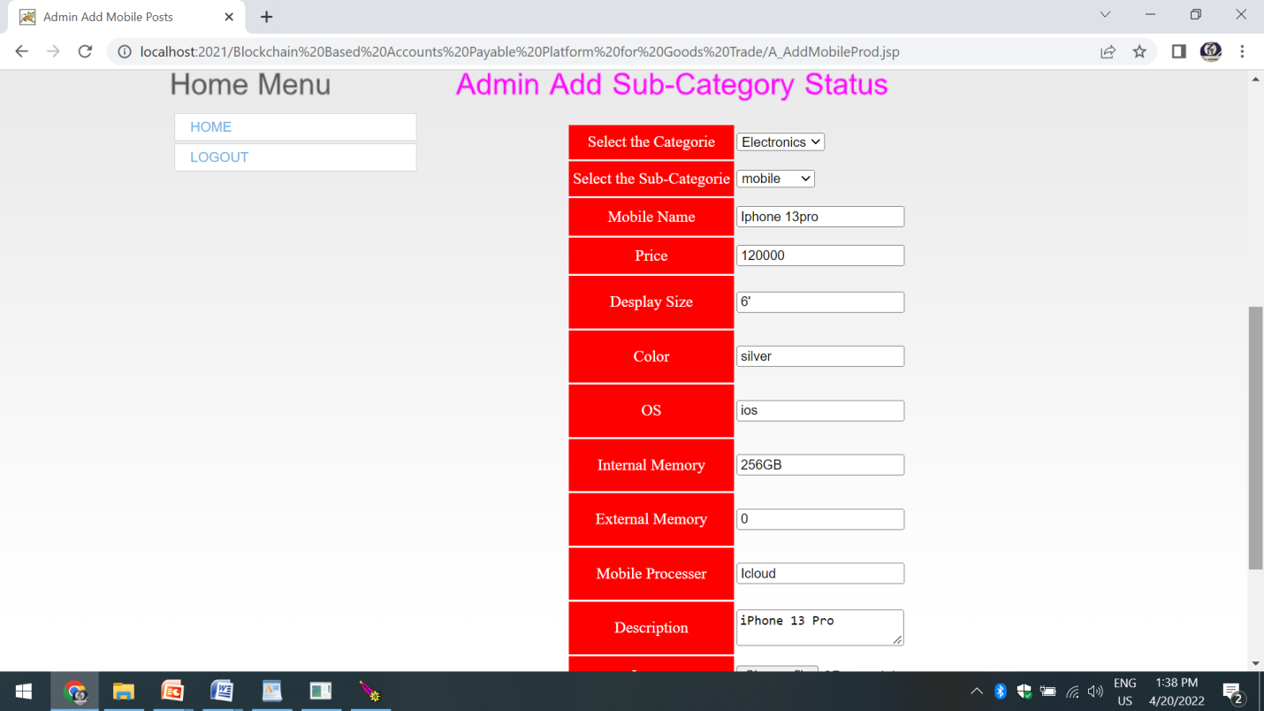

Slide 24
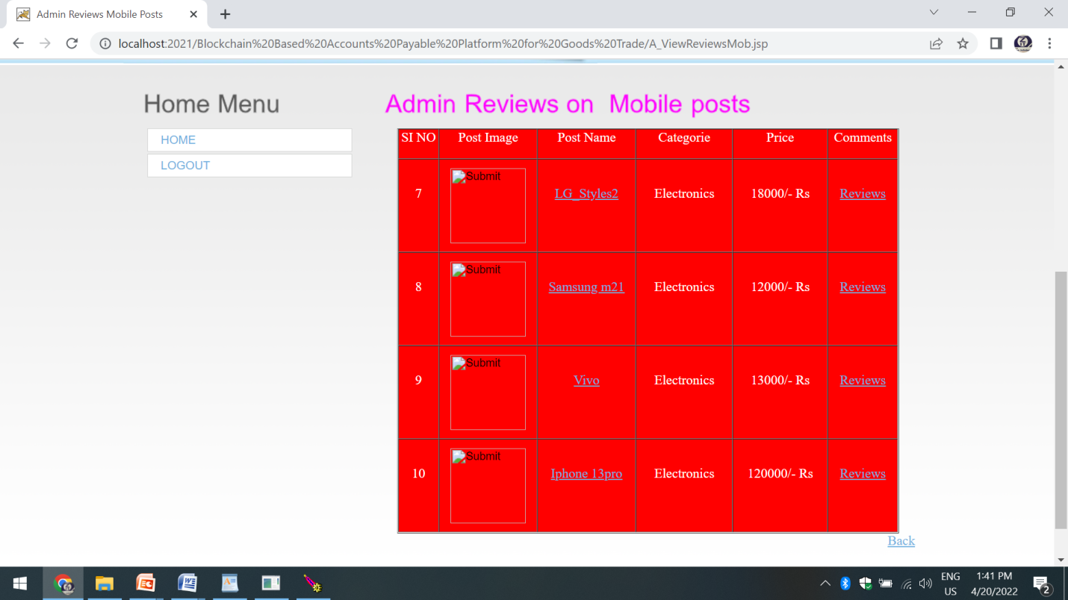

Slide 25
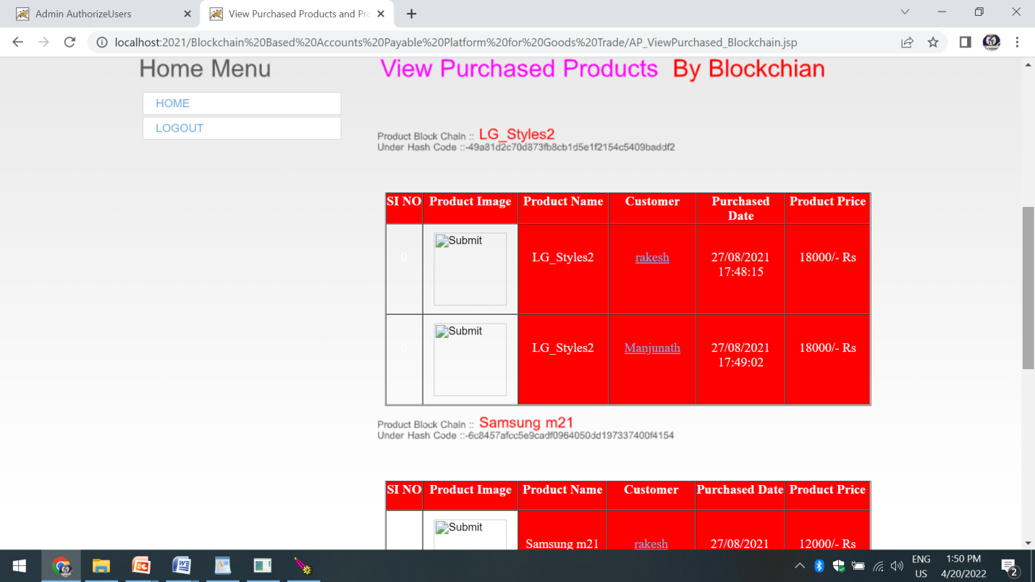

Slide 26
Conclusion:
we have proposed A Blockchain-based accounts payable system designed to streamline invoice processing and eliminate redundancies between accounts payable and receivable. The system categorizes claims into four types, aggregates them into claim advice, and uses this along with supplier and carrier invoices and real-time TradeLens data to generate payment advices. Built on Hyperledger Fabric and a cloud microservices architecture, the system ensures trusted invoice processing and transparent dispute resolution. Performance testing demonstrates its practicality for real-world deployment. The solution is currently being piloted with participants on the TradeLens platform..

Slide 27
Thank you
B. Srinivas (21N61A0548)
V. Rohan (21N61A0535)
A. Varun Kumar (21N61A0552)
V. Lavan Kumar (21N61A0527)

